Slide 1

Accident Prophet:
Predicting Road Incidents
REPORT!
Group 11
Mr. Nitesh Ghimire
Mr. Gholamreza Izadi
Mr. Tairo Kageyama
Mr. Rojan Manandhar
Mr. Panithi Sirisatjapipat
Mr. Bakyt Tursaliev

Slide 2
Table of contents
01
02
03
04
05
06
07
08
Introduction
Related work
Problem
Solution
Diagram
Mockup
Data set
Evaluation

Slide 3
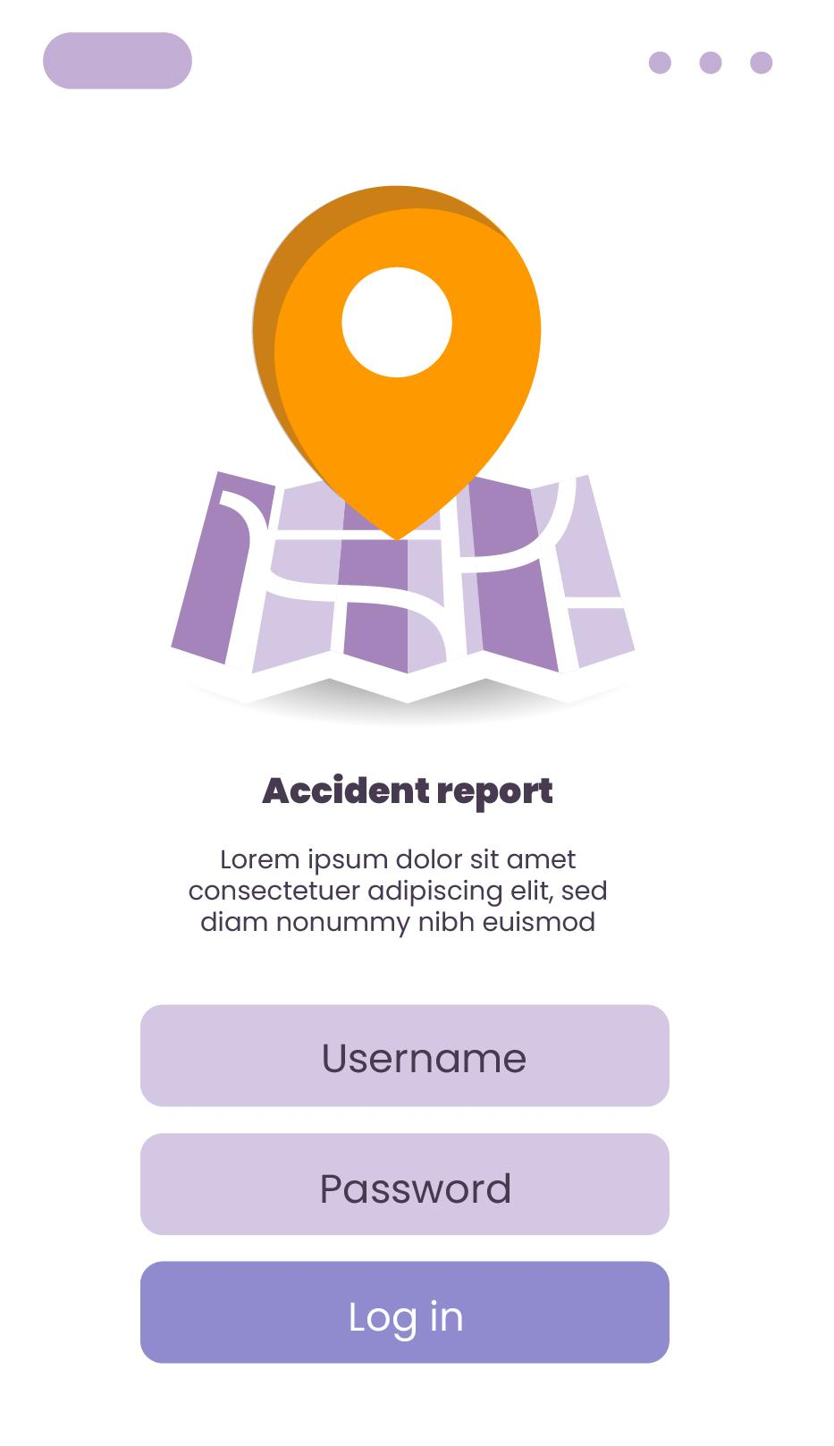
01
Introduction
ACCIDENT!

Slide 4
Predicting Road Accidents
Traffic accidents on our roadways have significant implications for public safety, traffic management, and the overall well-being of communities. The ability to respond quickly and effectively to accidents, as well as to predict their severity, is paramount.
Fatalities
Economic
According to the Centers for Disease Control and Prevention (CDC), each year, 1.35 million people are killed on roadways around the world.
It is estimated that fatal and nonfatal crash injuries will cost the world economy approximately 1.8 trillion dollars.

Slide 5
Fact & Data & Observation
Diagnosis
Nearly 1.25 million people die in road crashes each year, on average, 3,287 deaths a day.
Moreover, 20–50 million people are injured or disabled annually.
Road traffic crashes rank as the 9th leading cause of death and accounts for 2.2% of all deaths globally.
Implications
Road crashes cost USD 518 billion globally, costing individual countries from 1–2% of their annual GDP.
In the USA, over 37,000 people die in road crashes each year, and 2.35 million are injured or disabled.
Road crashes cost the U.S. $230.6 billion annually and are the leading cause of death for healthy U.S. citizens traveling abroad.

Slide 6
02
Related
Work
ACCIDENT!

Slide 7
Related Works
analysis of environmental attributes on accidents,
accident frequency prediction, and
accident risk prediction.
1
2
Liang, L. Y., Ma'Soem, D. M., & Hua, L. T. (2005). Traffic accident application using geographic information system.
Dhamaniya, A., Sonu, M., Krishnanunni, M., Praveen, P., & Jaijin, A. (2016). Development of Web Based Road Accident Data Management System in GIS Environment
3
4
Ahmed, S., Hossain, M. A., Ray, S. K., Bhuiyan, M. M. I., & Sabuj, S. R. (2023). A study on road accident prediction and contributing factors using explainable machine learning models.
Santos D, Saias J, Quaresma P, Nogueira VB (2021). Machine Learning Approaches to Traffic Accident Analysis and Hotspot Prediction.

Slide 8
03
Problem
ACCIDENT!

Slide 9
Problems
1
2
Challenges in
Road Accident Management
Key Issues
Road accidents are a persistent issue in regions like Thailand, impacting public safety, healthcare, and traffic management.
Lack of accessible tools and models for data-driven decision-making and accident prevention.
Absence of proximity-awareness systems for healthcare facility placement and road improvement.
No personalized driver guidance for reducing accident risks.
Missing models for classifying accident severity based on contributing factors.

Slide 10
Opportunities
1
2
Why it is important and
worth addressing
Positive Outcomes
automated data analysis on traffic behavior and impacts from accidents,
real-time car accident prediction,
studying car accident hotspot locations (using geohash levels: a square of sizes),
casualty analysis and risk assessment,
studying the impact of precipitation or other environmental stimuli on accident occurrence.
Increase accuracy for predictive analytics,
Reduction of efforts in emergency responses (the location, severity, other critical information),
assist drivers to avoid critical road situation,
real time monitoring and adjusting traffics,
deriving insights from data of road incidents and turn data into knowledge.

Slide 11
04
Solution
ACCIDENT!

Slide 12
Rationale
Providing critical insights to policymakers, healthcare providers, and the public is crucial
Develop a platform using data analytics and machine learning to predict accident trends, identify severity determinants, and offer recommendations.
Urgent need for user-friendly solutions to utilize accident data effectively.
Addressing these problems will reduce accident frequency and severity, enhancing overall road safety.

Slide 13
Value Propositions
Accurate Accident Prediction: Our product will accurately predict when and where accidents will likely occur.
Proximity-Awareness: Our platform will enable decision makers to position emergency services near accident-prone areas strategically.
Severity Classification: Users can access a severity classification model that offers insights into the potential impact of accidents.
Resource Optimization: The product will help allocate resources efficiently by directing resources to accident hotspots.
Personalized Driver Guidance: Drivers will receive customized guidance and warnings to reduce accident risks.

Slide 14
Target Audiences
Governments and Policy Makers
For data-driven decision-making and resource allocation.
Healthcare Providers
For proximity awareness and resource planning.
Drivers and Commuters
For personalized accident prevention guidance.
Data Scientists and Analysts
For insights into accident data and trends.

Slide 15
Requirement Elicitation
Real-Time Insights: The system must provide real-time accident risk assessment and guidance to drivers.
Severity Classification: It should classify accidents based on severity accurately.
User Engagement: High user engagement and usability of the platform.
Resource Allocation: The solution should help optimize healthcare and traffic management resources effectively.

Slide 16
Feasibilities
Collaboration with Authority
Preventive Measure
Infrastructure Requirement
Govt. agencies access data for coordinated preventive actions
Predict accidents and recommend actions like traffic signal adjustments or weather advisories for trust.
System needs resources like servers, cameras, sensors in road networks (e.g., MapQuest, Bing, or Google).
Data Availability
Regulatory Compliance
Access diverse data, including accidents, weather, infrastructure, and traffic.
Adhere to legal rules for accident prediction and data use for feasibility.

Slide 17
Risks
1
Data Quality and Availability
5
Competition
2
User Adoption
6
Regulatory and Ethical Compliance
3
Model Interpretability
7
Technical Challenges
4
Resource Constraints
8
Scalability

Slide 18
05
Diagram
ACCIDENT!

Slide 19
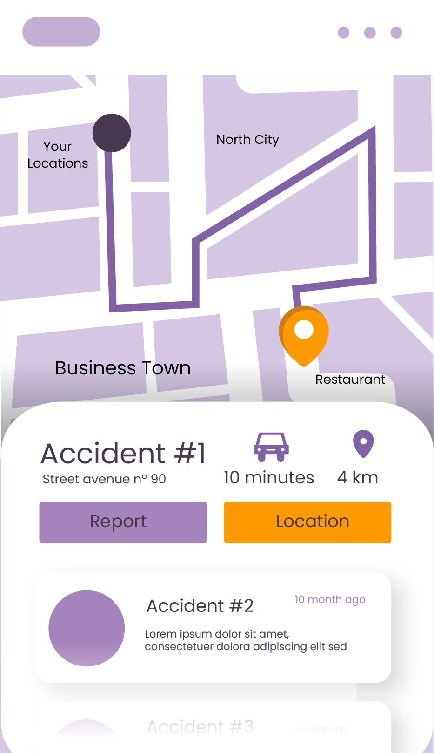
Software Architecture
REPORT!
Frontend:
HTML CSS, Jinja
Backend:
Framework : Flask
Database: SQLite
Version Control: Git, Gitlab
Libraries: Sklearn, numpy,
pandas, matplotlib, flask…
APIs:
Maps
Weather
Machine Learning
Framework: Sklearn
Model Versioning: Mlflow
Model Training: Jupyter Notebook
Infrastructure:
Container: Docker
Server:

Slide 20
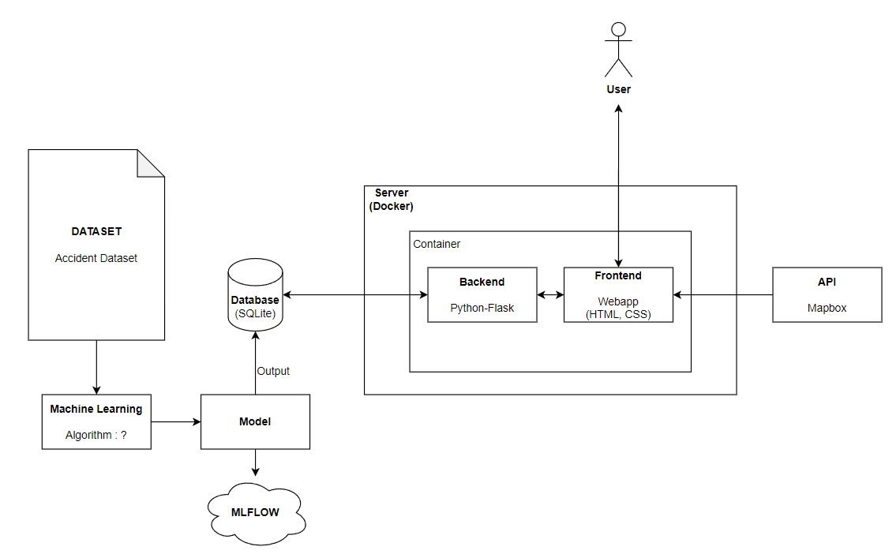
Software Architecture Diagram
Machine Learning algorithms:
Supervised classification
Unsupervised clustering
Deep learning

Slide 21
06
Mockup
ACCIDENT!

Slide 22
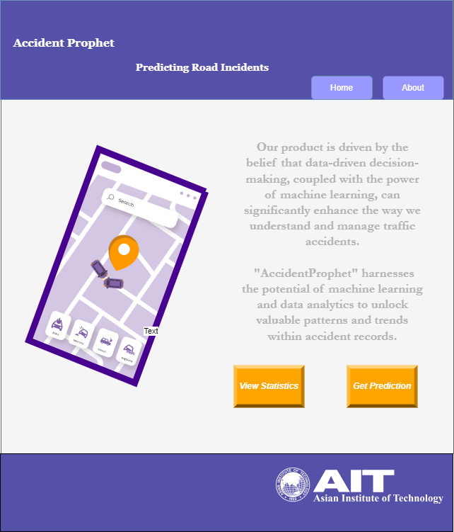
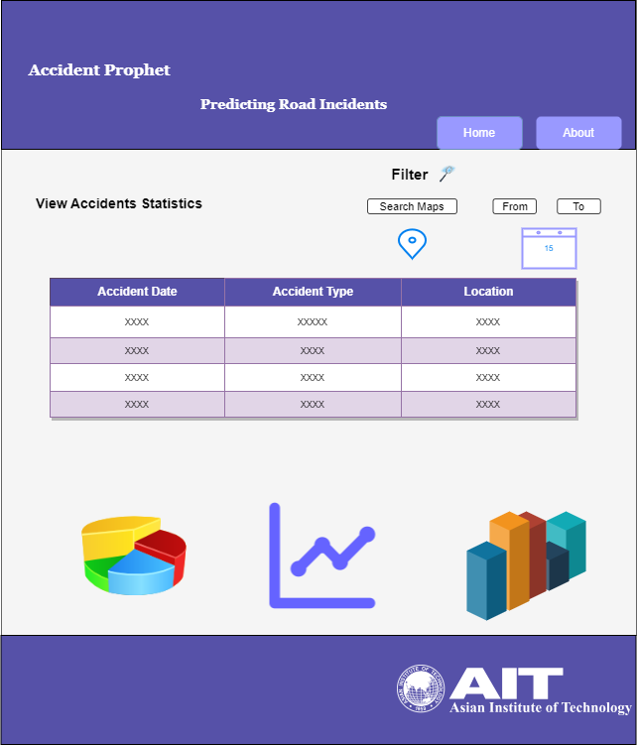
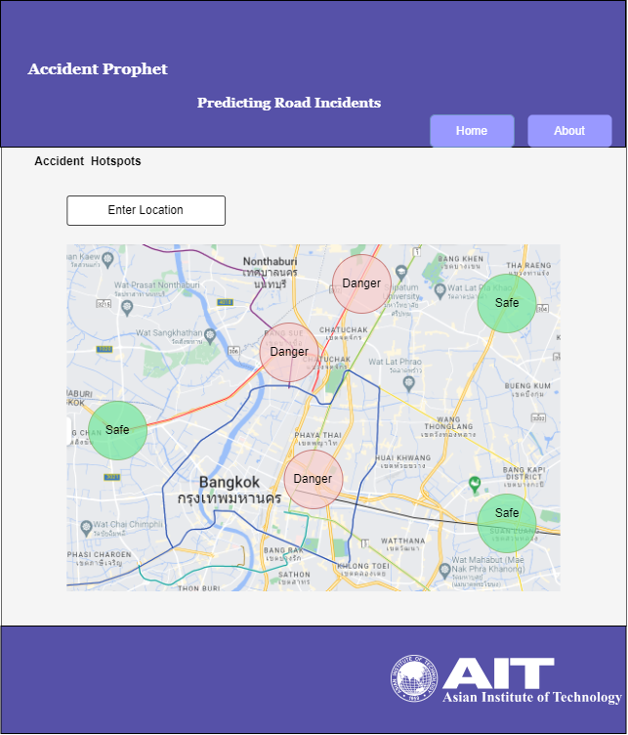
Mockups

Slide 23
07
Dataset
ACCIDENT!

Slide 24
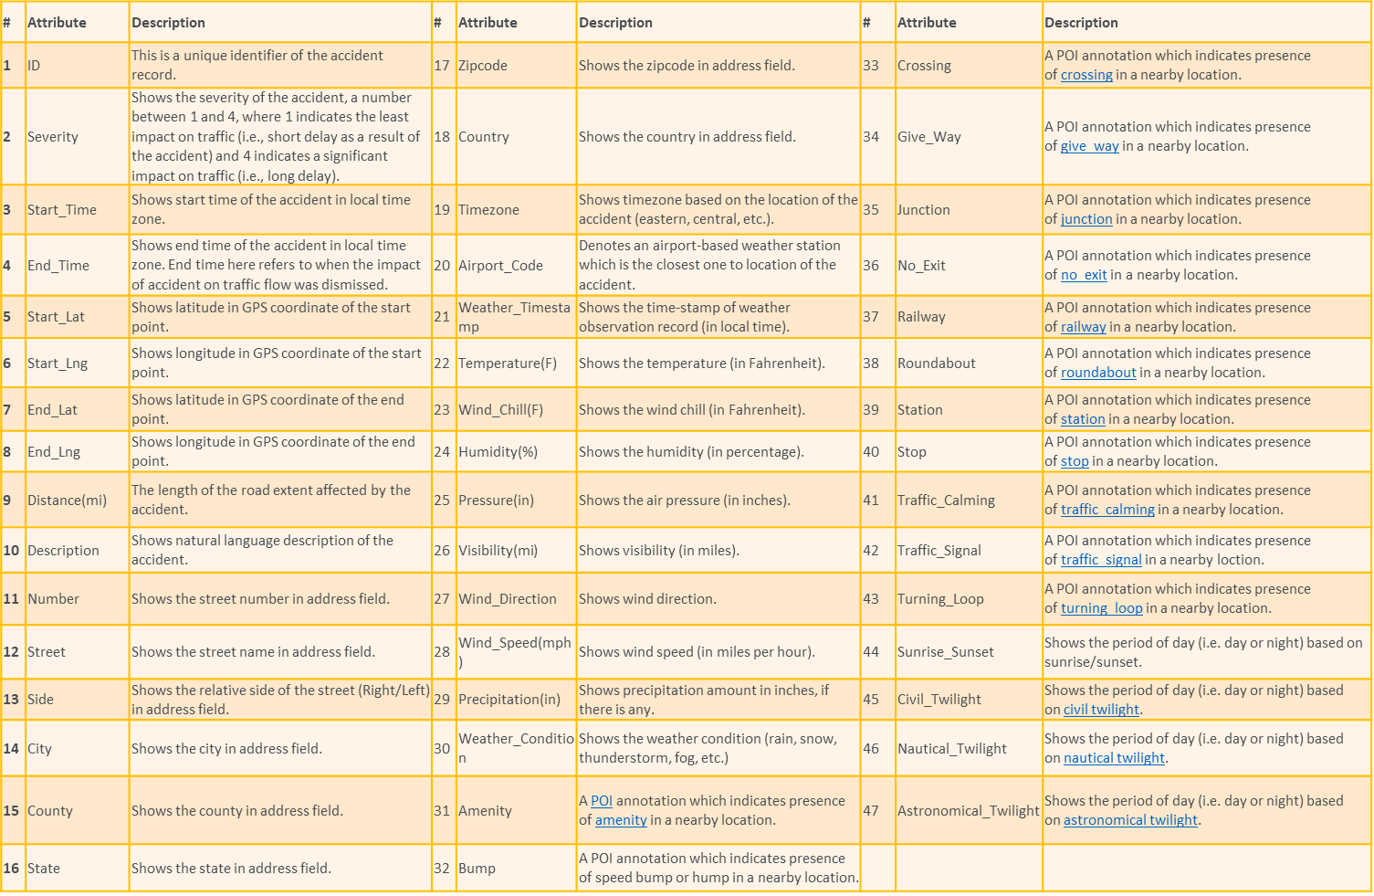
Data set
Countrywide car accident dataset that covers 49 states of the USA from February 2016 to March 2023.
Used APIs, broadcast traffic data captured by various entities, including the US and state departments of transportation, law enforcement agencies, traffic cameras, and traffic sensors within the road networks.
The dataset currently contains 7,728,394 million accident records. (5,410,394 train set, 2,318,000 test set)

Slide 25
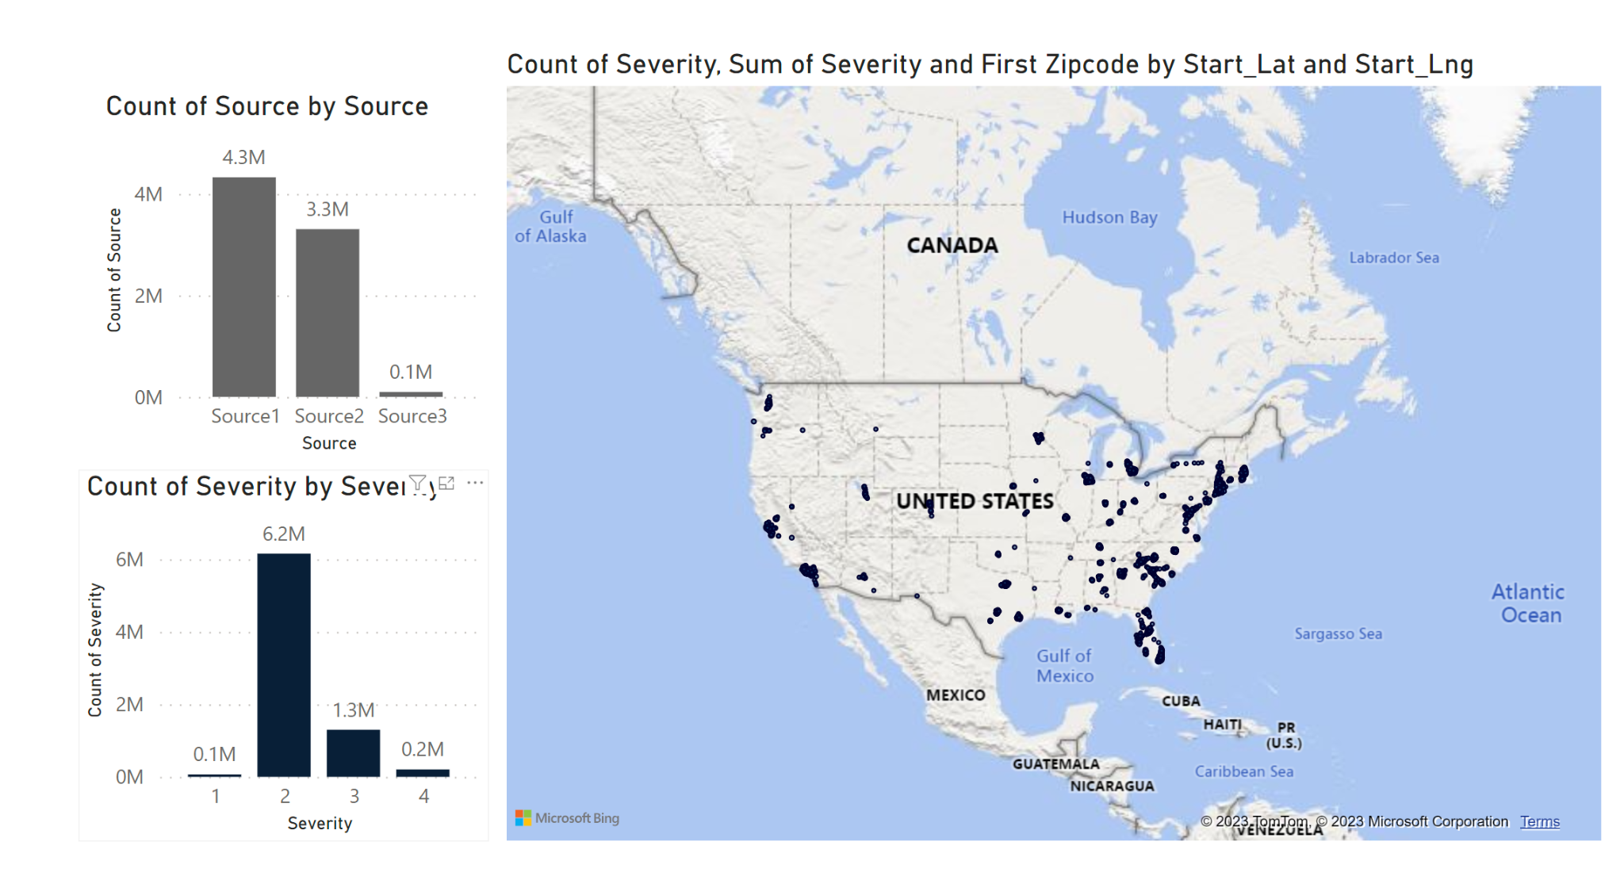
Data set

Slide 26
08
Evaluation
ACCIDENT!

Slide 27
Evaluations
Technical Evaluation
Human
Evaluation
Accuracy: Measures model's ability to predict accidents correctly, aiming for 90% or higher accuracy.
Recall: Evaluates the model's ability to correctly identify accidents, targeting at least an 85% recall rate.
Inference Speed: Crucial for real-time accident prediction, ensuring timely predictions within seconds.
Satisfaction: Gauges user contentment with platform's performance and recommendations through surveys and feedback.
Preference: Assesses user preference for the platform in accident prediction and prevention, comparing adoption rates before and after implementation. (A/B testing)

Slide 28

THANKS!
Do you have any questions?

